Slide 1
DDL STATEMeNTS
Instructor:

Slide 2

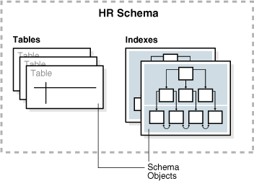
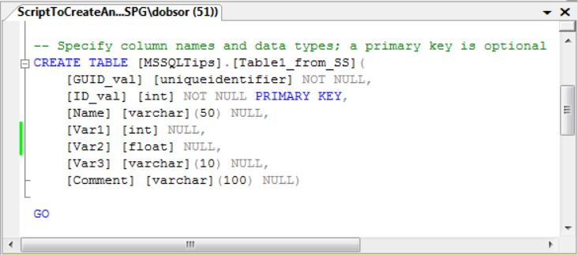
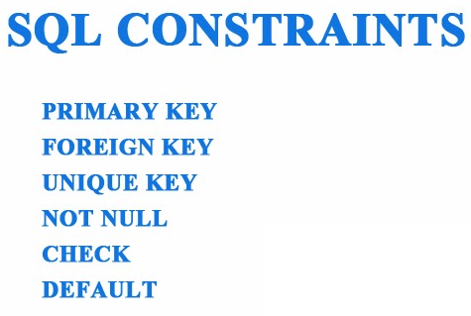
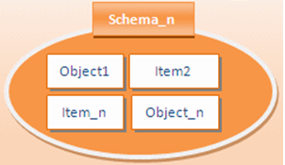
Learning Goals
By the end of this lecture students should be able to:
Categorize the main database objects
Create a simple table
Understand how constraints are created at the time of table creation
Describe how schema objects work
Understand and use to be commands create, alter, drop, truncate table

Slide 3
Table of contents
Introduction to DDL Statements
Database Object
Schema Object
Table and Constraints
Truncate
View

Slide 4
Introduction to DDL Statements
Section1

Slide 5
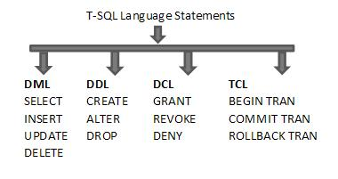
Introduction to DDL Statements
DDL stands for Data Definition Language
Define data structures in SQL Server as creating, altering, and dropping tables and establishing constraints…

Slide 6
SQL Server Database Objects
A SQL Server database has lot of objects like:
Database
Schema
Tables
Views
Stored Procedures
Functions
Rules
Defaults
Triggers
Notes:
Một Cơ sở dữ liệu SQL Server gồm nhiều đối tượng như:
/'ski:mə/
Chúng ta sẽ phân tích và demo các đối tượng này ở các slide sau.

Slide 7
DATABASE & SCHEMA OBJECTS
Section2

Slide 8
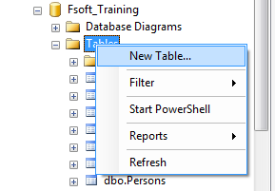
Database
SQL Server supports both scripts editor and graphic tool in order to:
Create a database
Rename a database
Drop a database

Slide 9
Database Demo
Scripts editor:
Create a database
Rename a database
Drop a database
Graphic tool
Create a database
Rename a database
Drop a database
Create database by using a template
Notes:
See DDL_Database_Demo.docx

Slide 10
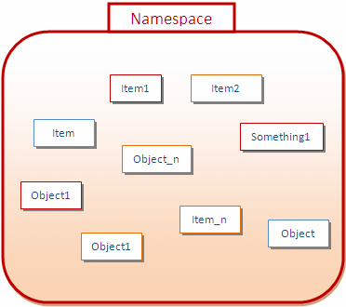
Schema Object (1/3)
A namespace can have objects inside

Slide 11
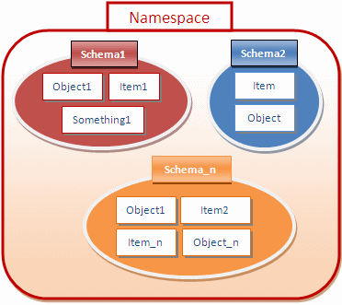
Schema Object (2/3)
To further control and manage the objects inside of a namespace, you can put them in sub-groups called schemas.
Notes:
Khi một số đối tượng này có mục đích giống nhau bạn đặt chúng vào các nhóm con và được gọi là lược đồ.

Slide 12
Schema Object (3/3)
Schema default:
dbo is default schema in every database
Ex: SalesOrderDetail, HumanResources.Department
[linked-server].[DBName].[SchemaName].[Objectname]
Schema as:
naming boundaries
security boundaries

Slide 13
Table and Constraints
Section3

Slide 14
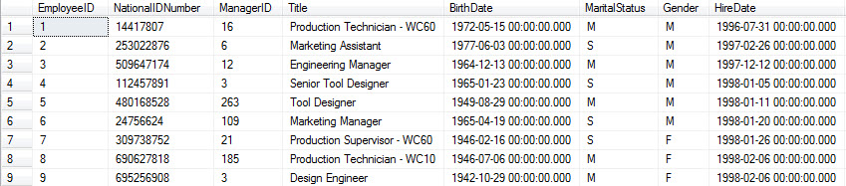
Table
Table is a repository for data, with items of data grouped in one or more columns
Data types
Constraints
Index

Slide 15
Table demo
Create table
Alter table
Add new column
Change data type of existing column
Delete a column
Add or remove constraints
Drop table
Remove table structure and its data.

Slide 16
Table Constraints (1/4)
Table Constraints: Are used to limit the type of data that can go into a table.
We will focus on the following constraints:
NOT NULL
CHECK
UNIQUE
PRIMARY KEY
DEFAULT
FOREIGN KEY

Slide 17
Table Constraints (2/4)
NOT NULL: Specifies that the column does not accept NULL values.
CHECK: Enforce domain integrity by limiting the values that can be put in a column.
Syntax:
[CONSTRAINT constraint_name]
CHECK (condition)

Slide 18
Table Constraint (3/4)
UNIQUE: Enforce the uniqueness of the values in a set of columns
Synstax:
CONSTRAINT unique_name UNIQUE (col_names)
PRIMARY KEY: Specify primary key of table.
Syntax:
[CONSTRAINT PK_Name]
PRIMARY KEY [col_names]

Slide 19
Table Constraint (4/4)
FOREIGN KEY: Used to define relationships between tables in the database.
Syntax:
[CONSTRAINT FK_Name]
FOREIGN KEY [(col_names)]
REFERENCES reference_table(col_names)
DEFAULT: Defaults specify what values are used in a column if you do not specify a value for the column when you insert a row.

Slide 20
SQL Constraints Scope
SQL constraints can be applied at:
Table level
Are declared independently from the column definition
declare table-level constraints at the end of the CREATE TABLE statement
Column level:
Are declared when define columns for the table.
It is applied particularly to the column where it attached to

Slide 21
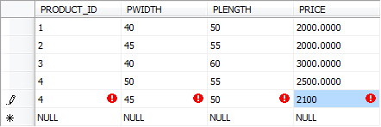

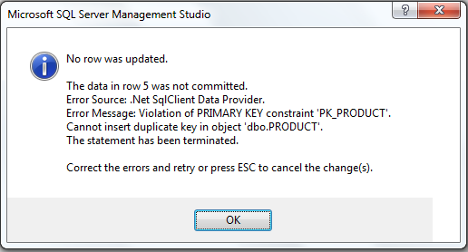
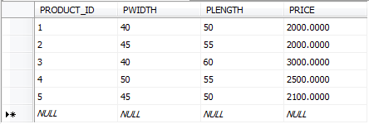
Identity (1/1)
Primary key
Auto increment
Error
Notes:
Sequences are frequently used in databases because many applications require each row in a table to contain a unique value, and
sequences provide an easy way to generate them.

Slide 22
Identity (1/2)
Identity has:
A seed
An increment
Seed is the initial value
Increment is the value by which we need to skip to fetch the next value
For example:
Identity(1,2) will generate sequence numbers 1,3,5,7…
1
2
3
4
5
…
1
4
7
10
13
…
1
3
5
7
9
…
Identity(1,1)
Identity(1,3)
Identity(1,2)

Slide 23
Truncate statement
Removes all rows in a table.
Table structure and its columns, constraints, indexes, …remain.
Resets the identity value.
Releases the memory used.

Slide 24
VIEWs
Section4

Slide 25
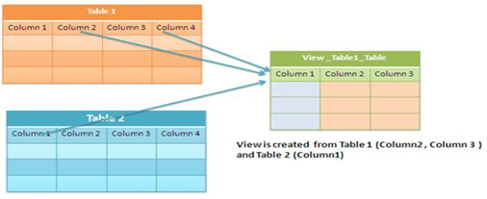
What is a view?
A View is a logical or virtual table. The fields in a view are fields from one or more real tables in the database.
There are two major reasons you might want to use views:
Views allow you to limit the data users can access
Views reduce complexity for end users.
Notes:
Database views allow you to create virtual tables based upon query results.
There are two major reasons you might want to use views instead of provid-
ing users with access to the underlying database table(s) themselves:
Views allow you to limit the data users can access. For example, you
can create a view that returns only certain rows from a table and then
grant users permission to access the view. They won’t be able to access
rows in the table that don’t meet the criteria of the view.
Views reduce complexity for end users. If end users aren’t comfortable
writing complex SQL queries, you can write the query for them and then
hide the complexity in a view

Slide 26
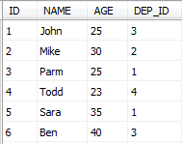
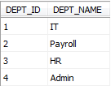
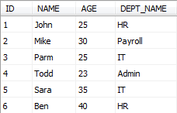
Creating a view
CREATE VIEW View_Name [list of column names]
AS
SELECT…
Table: DEPARTMENT
Example:
Table: EMP
CREATE VIEW view_EmployeeByDpt
AS
SELECT ID, NAME, AGE, DEPT_NAME
FROM EMP, DEPARTMENT
WHERE EMP.DEP_ID = DEPARTMENT.DEPT_ID
view_EmployeeByDpt
SELECT * FROM view_EmployeeByDpt

Slide 27

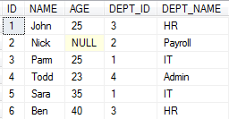

Deleting a view
Syntax:
Example:
DROP VIEW View_Name
DROP VIEW view_EmployeeByDpt
view_EmployeeByDpt

Slide 28

Summary
Introduction to DDL Statements
SQL Server Database Objects
Database Object
Create, Rename, Drop a database: Graphic, Scripts, Template
Schema Object
What is schema in database? Schema default?
Table and Constraints
Create, Alter, Drop Table. NOT NULL, CHECK, UNIQUE, PRIMARY KEY, DEFAULT, FOREIGN KEY
SQL View

Slide 29

Thank you

